Slide 1
Set
In C++, sets are associative container which stores unique elements in some sorted order.
By default, it is sorted ascending order of the keys

Slide 2
Creating a set
#include <iostream>
#include <set>
using namespace std;
int main() {
// Creating a set of integers
set<int> s = {3, 5, 2, 1};
for (auto x : s)
cout << x << " ";
return 0;
}
Output
1 2 3 5

Slide 3
Inserting elements
#include <bits/stdc++.h>
using namespace std;
int main() {
set<int> s = {1, 4, 2};
// Insert elements into set
s.insert(5);
s.emplace(3);
s.insert(5);
for (auto x: s) cout << x << " ";
return 0;
}
Output
1 2 3 4 5

Slide 4
Accessing elements
#include <bits/stdc++.h>
using namespace std;
int main() {
set<int> s = {1, 4, 2, 3, 5};
// Accessing first element
auto it1 = s.begin();
// Accessing third element
auto it2 = next(it1, 2);
cout << *it1 << " " << *it2;
return 0;
}
Output
1 3

Slide 5
Finding elements
#include <bits/stdc++.h>
using namespace std;
int main() {
set<int> s = {1, 4, 2, 3, 5};
// Finding 3
auto it = s.find(3);
if (it != s.end()) cout << *it;
else cout << "Element not Found!";
return 0;
}
Output
3

Slide 6
Traversing elements
#include <bits/stdc++.h>
using namespace std;
int main() {
set<int> s = {5, 1, 4, 3, 2};
// Traversing using traditional for loop
for(auto it = s.begin(); it != s.end(); it++)
cout << *it << " ";
return 0;
}
Output
1 2 3 4 5

Slide 7
Deleting elements
#include <bits/stdc++.h>
using namespace std;
int main() {
set<int> s = {1, 4, 2, 3, 5};
// Deleting elements by value
s.erase(5);
// Deleting first element by iterator
s.erase(s.begin());
for (auto x: s) cout << x << " ";
return 0;
}
Output
2 3 4

Slide 8
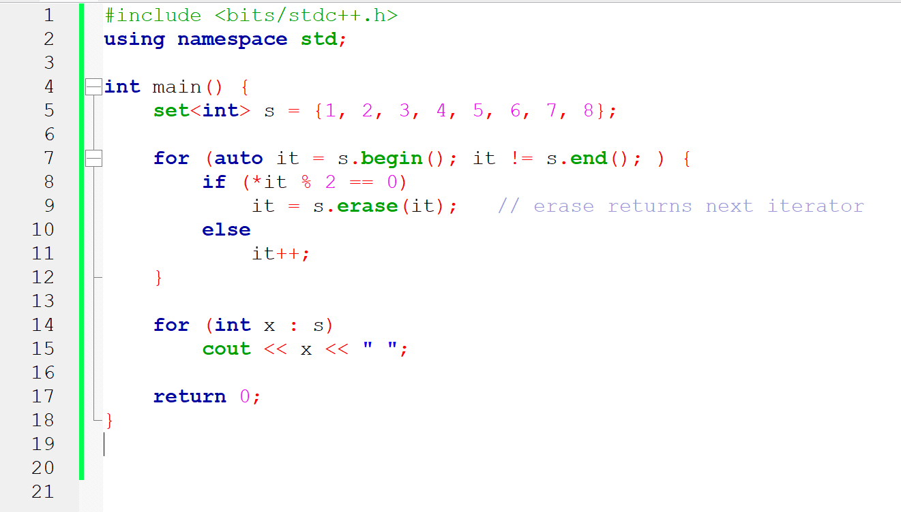
#if an element in a given set is even, delete it

Slide 9
Updating elements
We cannot change the value of elements once they are stored in the set.

